Slide 1
Bike Sharing Assignment
Sandeep A Nair

Slide 2
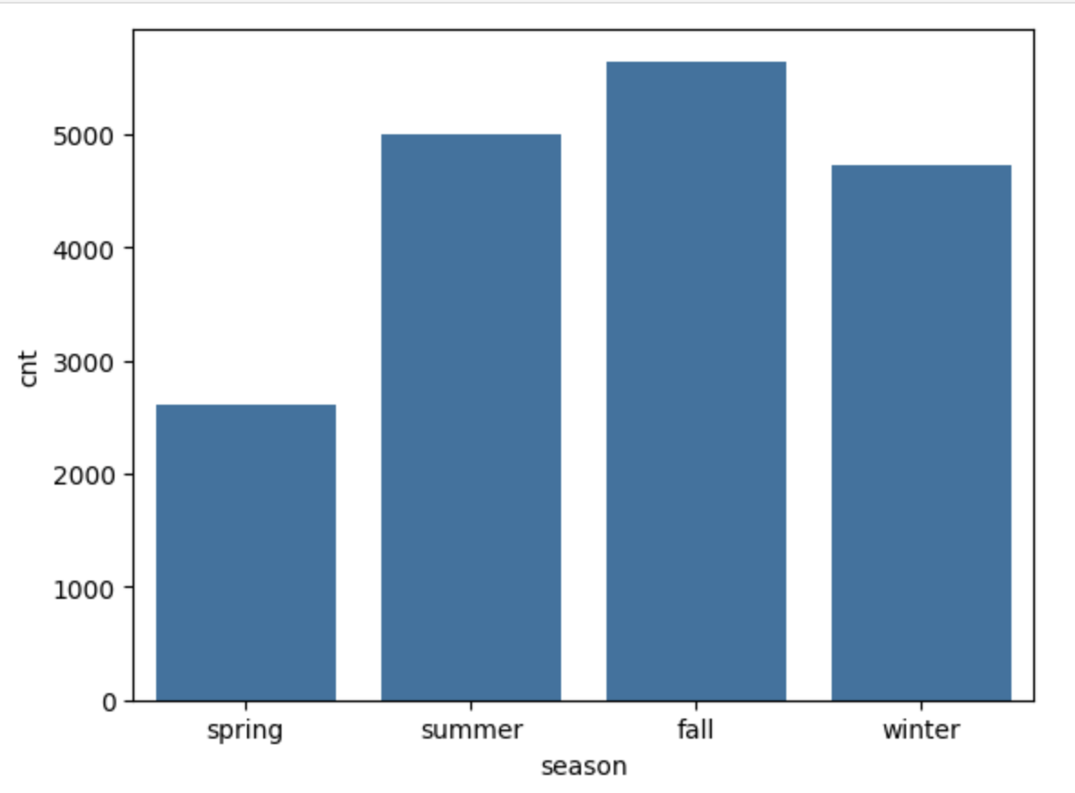
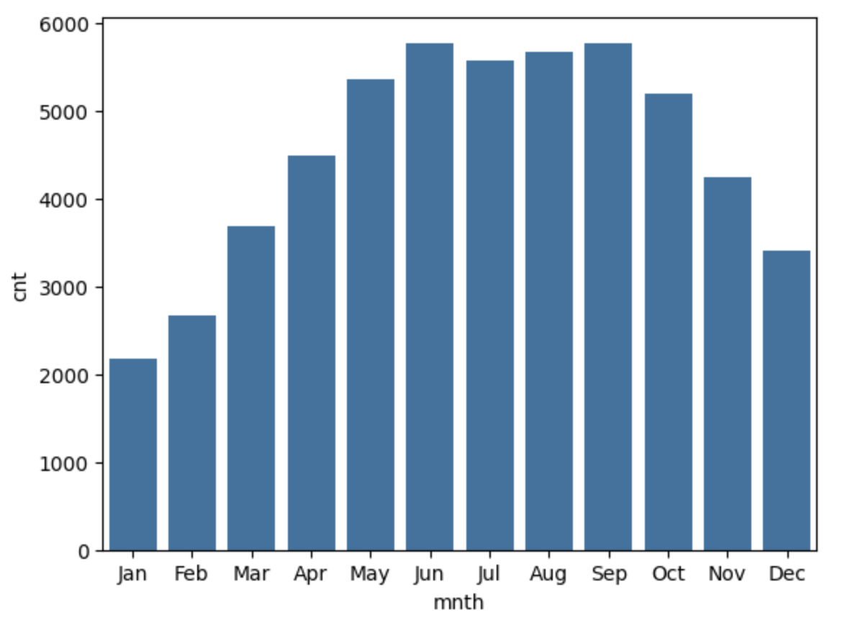
From your analysis of the categorical variables from the dataset, what could you infer about their effect on the dependent variable?
The above graphs show that during the months of Summer and Fall season most of the bikes are rented
And the least number of bikes are rented during Spring season months

Slide 3
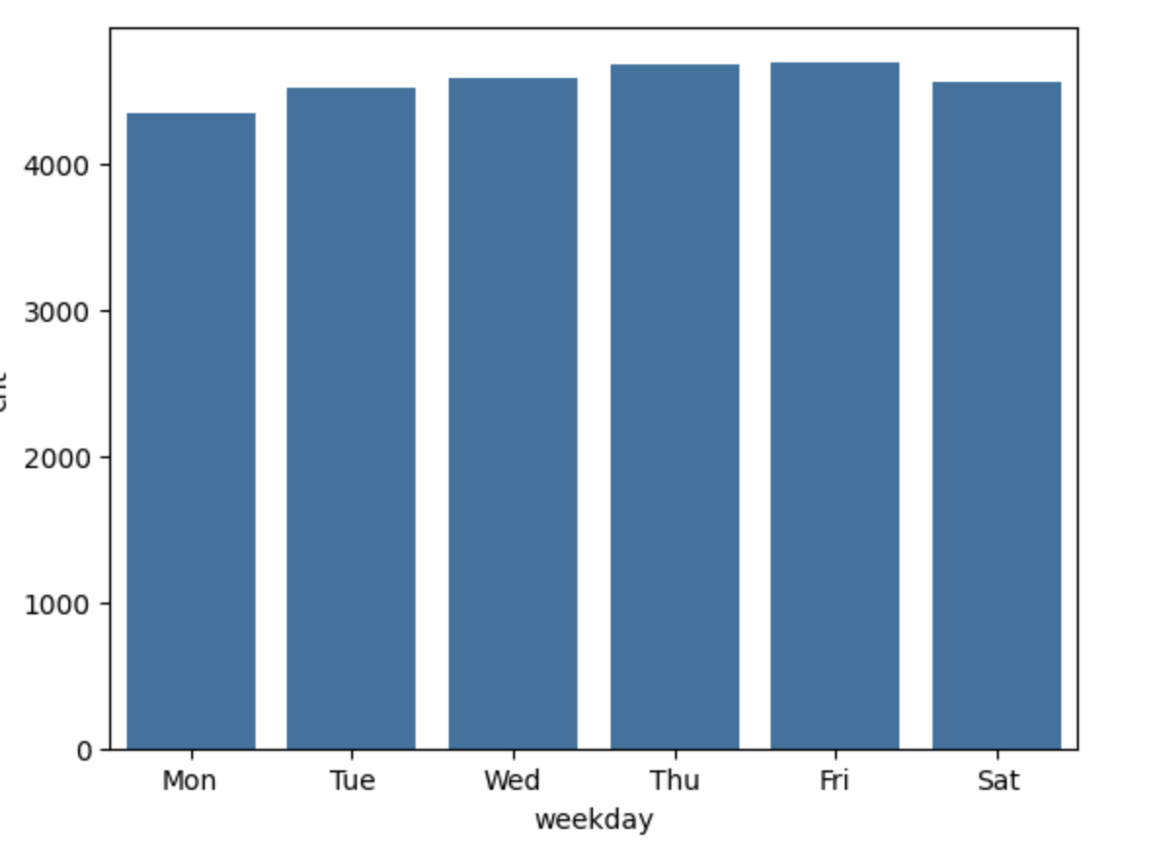
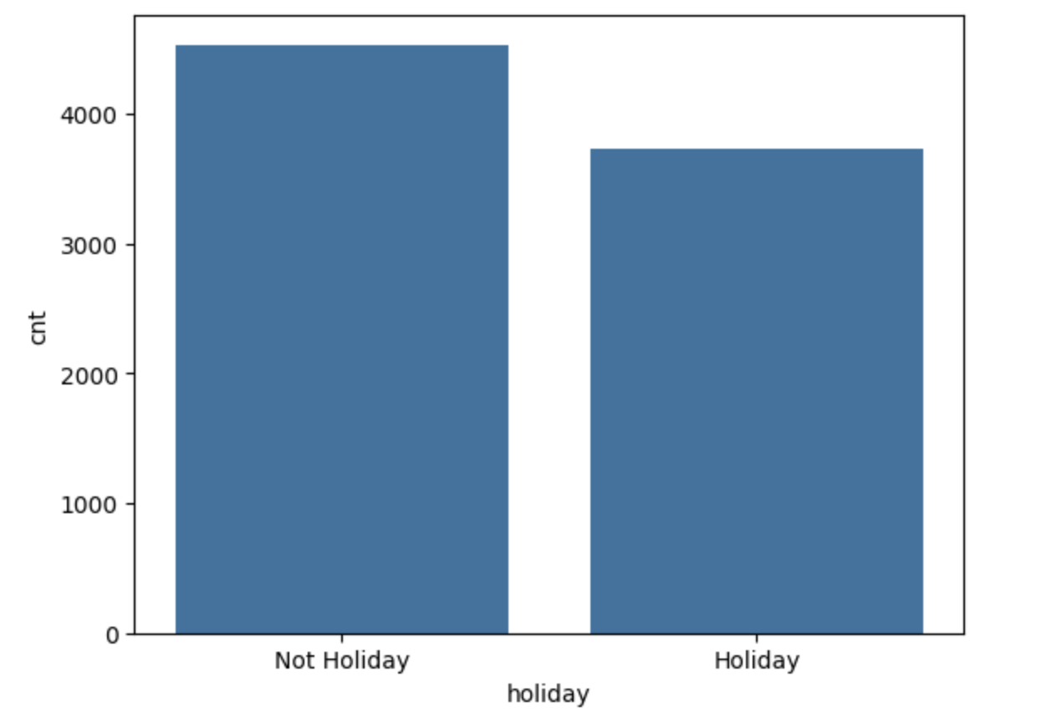
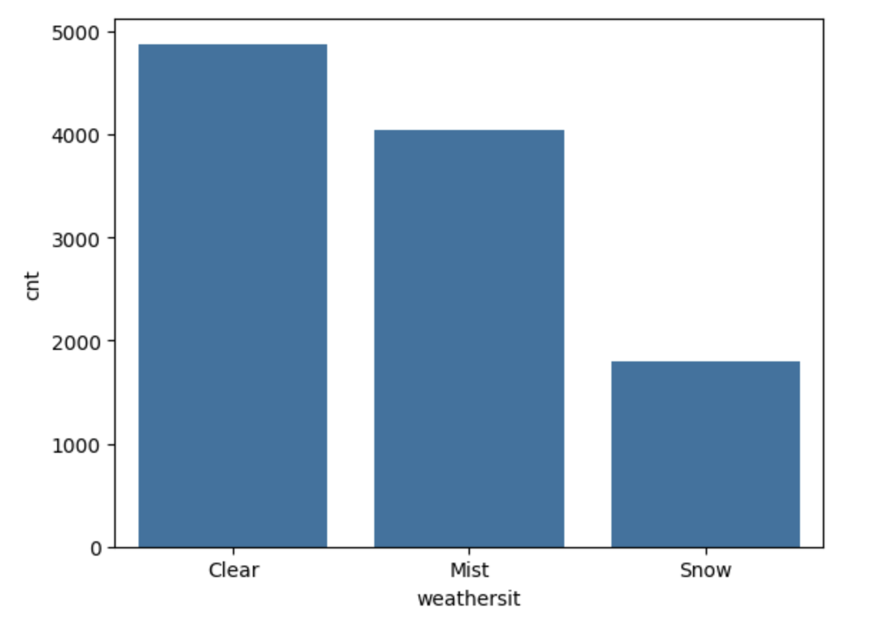
While we do not see any particular relationship between the Weekdays and the number of bikes rented, we see on an average bikes are rented more during a Non-holiday than during a holiday.
Also we notice that a lot more bikes are rented during clear weather and there is a drop off in renting bikes during snow.
There is no data present on rainy conditions

Slide 4
Why is it important to use drop_first=True during dummy variable creation?
It is important to use drop_first=True during dummy variable creation because we need to reduce the correlation between the dummy variables. The dropped column can be inferred from the rest of the columns that are added and hence that relationship is removed.
This also helps to reduce the cardinality of the equation

Slide 5
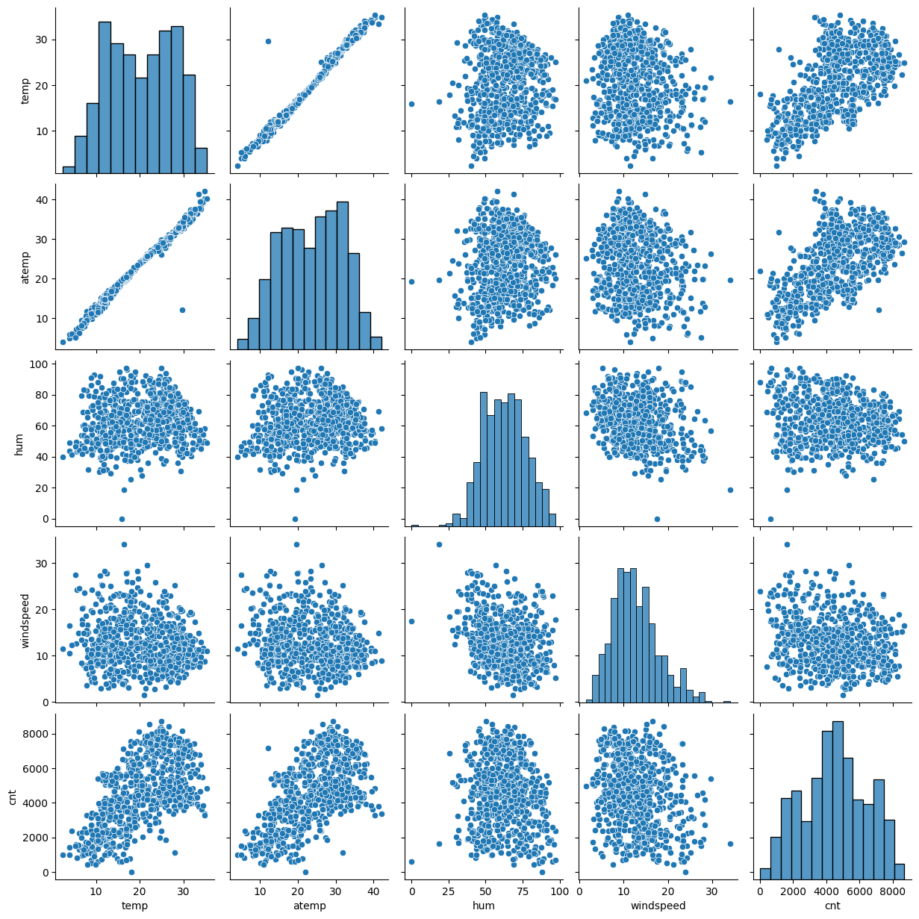
Looking at the pair-plot among the numerical variables, which one has the highest correlation with the target variable?
Looking at the pair plots of the numerical variables we can see that there seems to be a linear relation between the temperature and the Count of number of bikes that are rented whereas Humidity and Windspeed do not show any particular relationship the count.
We also notice that atemp and temp are higly collinear and can cause problems while making the model and it would be best to drop one of them since they both show same relationship

Slide 6
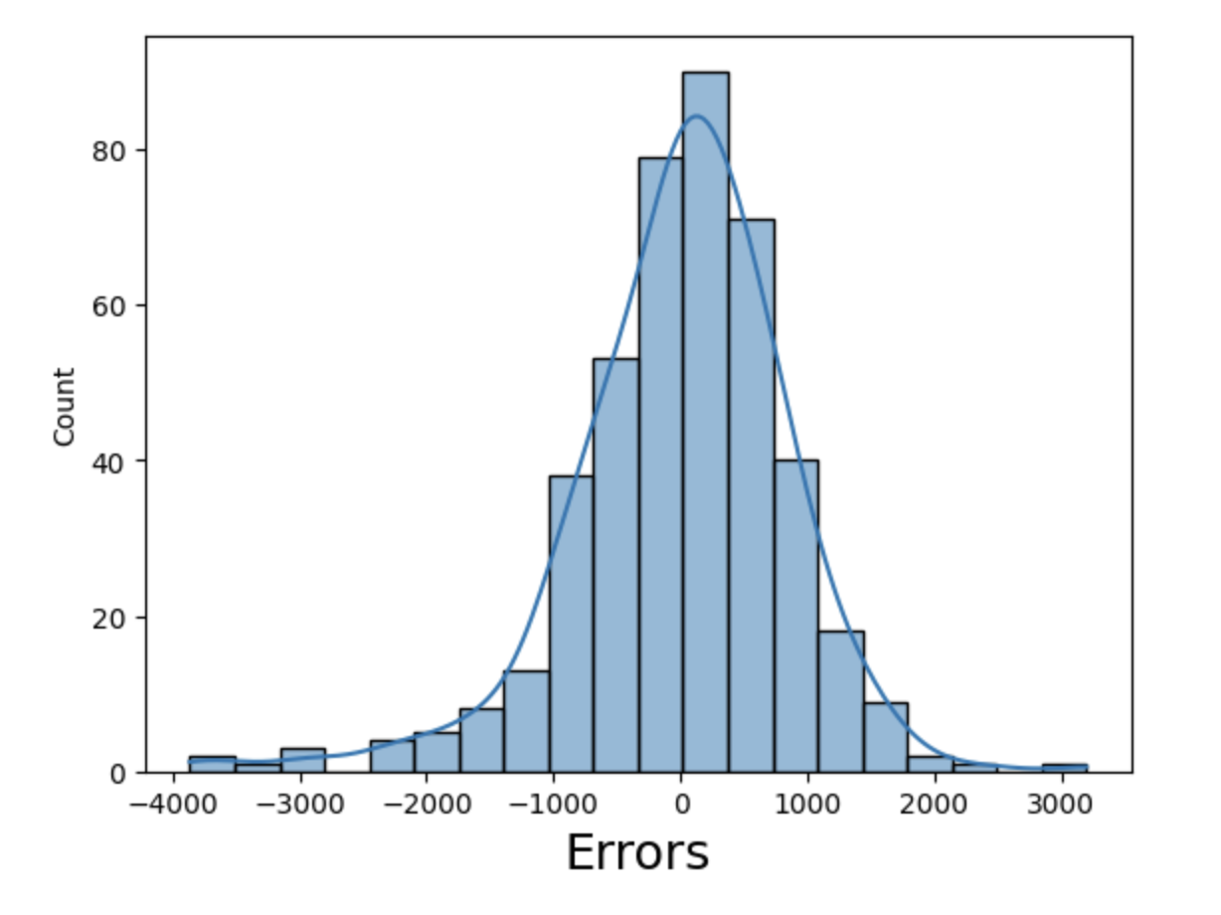
How did you validate the assumptions of Linear Regression after building the model on the training set?
Residuals distribution should follow normal distribution and centered around 0 (mean = 0). We validated this assumption about residuals by plottng a histogram of residuals and see if residuals are following normal distribution or not.
Looking at the R^2 number shows a value of 0.806(80.6%), which is a good number
Also the Prob F-stat is under 0.05 which shows that the regression model is meaningful

Slide 7
Based on the final model, which are the top 3 features contributing significantly towards explaining the demand of the shared bikes?
Temperature - Positive
Year - Positive
Snowy weather – Negative
Spring Season - Negative
Winter Season - Positive
are the biggest contributors.
This shows that the business is growing customers as the years pass and customers are more likely to rent a bike when the temperature starts rising and the snow stops.
Ignoring Year the next significant feature is Season being Spring that contributes negatively

Slide 8
Explain the linear regression algorithm in detail.
Linear regression is a type of supervised machine learning that predicts the importance of independent variables in predicting a dependent one.
It is based off of the equation of a line. If there is a single Independent variable then it is called Simple Linear Regression else it’s called Multiple Linear Regression.
The goal of the algorithm is to find a best fit line that represents all the independent variables present in the data and can predict for other values of these independent variables
The algorithm works by trying to minimize the Mean Squared Error or the MSE between the predicted values and the actual values of the dependent variable. This works by adjusting the coefficients of the independent variables in the equation over a gradient to achieve the best fit, there are other methods to achieve this as well.

Slide 9
Explain the Anscombe’s quartet in detail
Anscombe’s quartet comprises a set of four datasets, having identical descriptive statistical properties in terms of means, variance, R-squared, correlations, and linear regression lines but having different representations when we scatter plots on a graph.
The purpose of Anscombe’s quartet is to show the importance of exploratory data analysis and visualizing data and not relying on summary statistics alone.
The four datasets that make up Anscombe’s quartet each include 11 x-y pairs of data. When plotted, each dataset seems to have a unique connection between x and y, with unique variability patterns and distinctive correlation strengths.
Despite these variations, each dataset has the same summary statistics, such as the same x and y mean and variance, x and y correlation coefficient, and linear regression line. This shows how easy it is to fool a regression algorithm

Slide 10

What is Pearson’s R?
The Pearson correlation coefficient (r) is the most common way of measuring a linear correlation. It is a number between –1 and 1 that measures the strength and direction of the relationship between two variables.
0 being no correlation, 0 - 1 being positive correlation and 0 – (-1) being negative correlation
The Pearson correlation coefficient is also an inferential statistic, meaning that it can be used to test the statistical hypotheses. Specifically, we can test whether there is a significant relationship between two variables in the data
The formula used to calculate Pearson’s R is
It is a good choice to use when Both variables are quantitative, The variables are normally distributed, The data have no outliers, The relationship is linear

Slide 11
What is scaling? Why is scaling performed? What is the difference between normalized scaling and standardized scaling?
Scaling is a step of data Pre-Processing which is applied to independent variables to normalize the data within a particular range. It also helps in speeding up the calculations in an algorithm.
Data set contains features highly varying in magnitudes, units and range. If scaling is not done then algorithm only takes magnitude in account and not units hence incorrect modelling. To solve this issue, we have to do scaling to bring all the variables to the same level of magnitude.
Normalized scaling brings all values between the range of 0 to 1
Standardized scaling replaces the values with their Z-scores thereby bringing the data into a normal distribution with a mean and standard deviation
One disadvantage of normalization over standardization is that it loses some information in the data, especially about outliers.

Slide 12
You might have observed that some cases the value of VIF is infinite. Why does this happen?
VIF is an index that provides a measure of how much the variance of an estimated regression coefficient increases due to collinearity. In order to determine VIF, we fit a regression model between the independent variables.
In the context of VIF, infinity represents perfect correlation, and as VIF values increase, the reliability of the regression results decreases.
If the independent variable can be perfectly explained by other independent variables then the R value will be 1 with means the R^2 value is also 1.
Substituting this in the formula for VIF which is VIF = 1 / (1 — R2) we get VIF = 1/(1-1).
This results in the infinite value that we see in some cases

Slide 13
What is a Q-Q plot? Explain the use and importance of a Q-Q plot in linear regression
A Q-Q plot is a scatterplot created by ploting two sets of quantiles against one another. It is used to compare the shapes of distributions . If both sets of quantiles came from the same distribution, we should see the points forming a line that’s roughly straight. The Q-Q plot is used to answer the following questions:
Do two data sets come from populations with a common distribution
Do two data sets have common
location and scale?
Do two data sets have similar distributional shapes?
Do two data sets have similar tail behavior?

